Slide 1
Todo List Application RESTful API
E-Commerce Campaign Planner
Massimiliano Stefanuzzi
Contact: m.stefanuzzi@gmail.com

Slide 2

Are you managing a small E-Commerce Business? Looking for an Application which help you to plan and assign the different tasks between the team members?

Slide 3
Dedicate to the business core functions keeping everything under control!

Slide 4
Marketing Campaign Planner
Organizes e-commerce campaigns like sales, email marketing, and social media
promotions.
Features:
CRUD for campaign tasks.
Categories: email drafts, social media posts, discount schedules.
Assign deadlines for campaign phases.
User access for marketers and managers.

Slide 5
Project Details
Why a Marketing Campaign Planner?
To improve marketing efficiency and deadline management.
Which tools and operations?
Designed and implemented RESTful APIs with FastAPI.
Developed CRUD operations, user authentication, and categorized tasks.
Which result?
A functional API that boosts task visibility and team coordination.
E-commerce teams can meet deadlines and increase operational efficiency.
Challenges & Solutions:
Challenge: Configuring user authentication. Solution: Used FastAPI’s OAuth2 and PyJWT for token-based authentication.
Challenge: Handling data consistency. Solution: Utilized SQLAlchemy for database management.

Slide 6
Process
Turning Ideas Into Code
Setup Database
Database Tables (Models)
Main (Create Database Connection for API)
Todos Setup with SQLite
Authentication & Authorization
Routers Authentication File & Routers Todos File
Foreign Keys (One to many Relationship)
Assignee Hash Password & JWT (JSON Web Token)
Todo List Setup with SQLite
Authenticate Request

Slide 7
Missing Parts
Unsolved Validation Issues
Pytest Unit & Integration Testing
Documentation
Swagger/OpenAPI for API documentation
Postman collection for API testing
Authentication & Authorization
Routers Authentication File & Routers Todos File
Foreign Keys (One to many Relationship)
Assignee Hash Password & JWT (JSON Web Token)

Slide 8
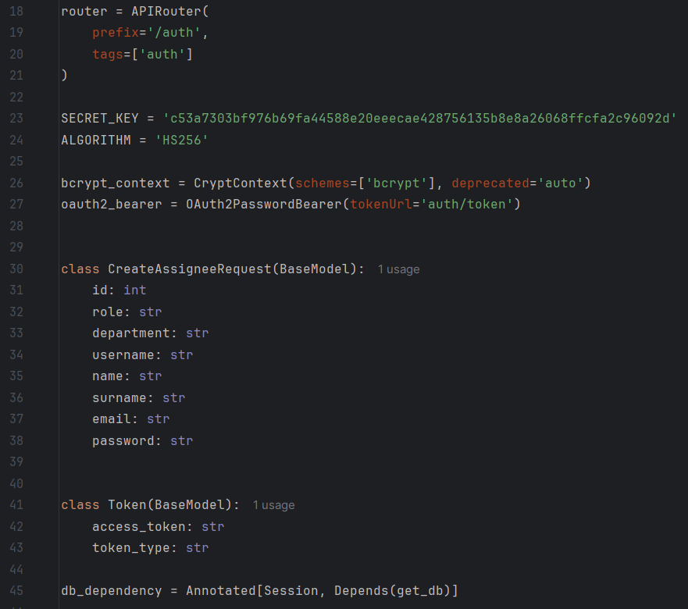
Authorize

Slide 9
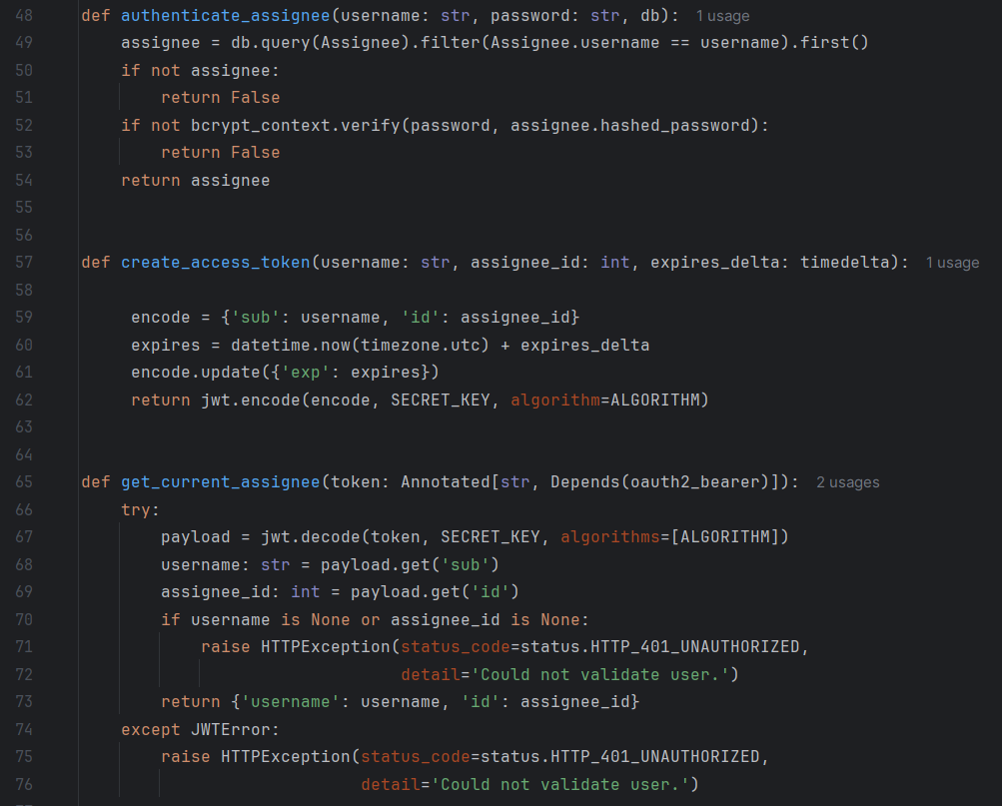
Authorize

Slide 10
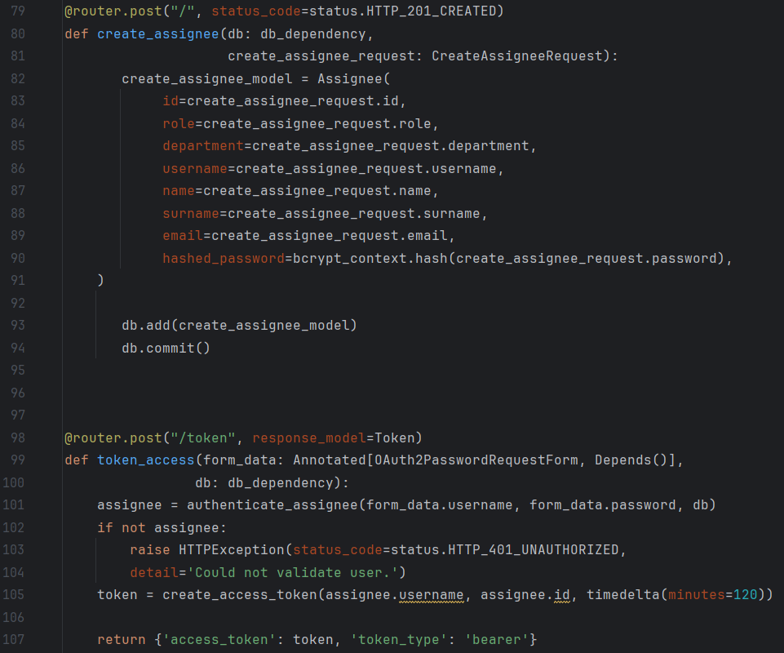
Authorize

Slide 11
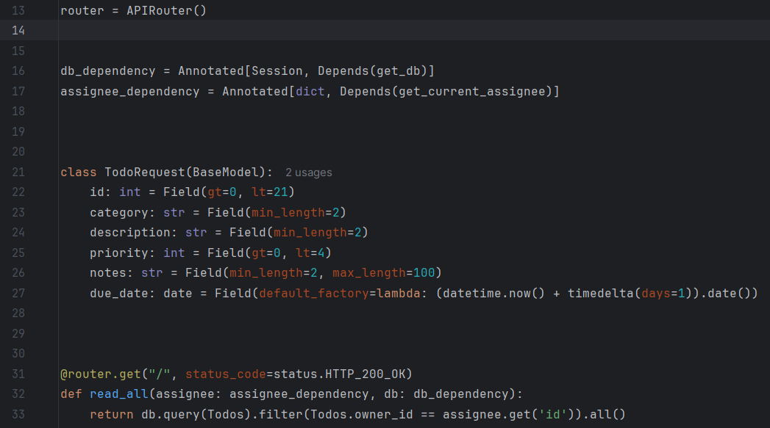
Todos

Slide 12
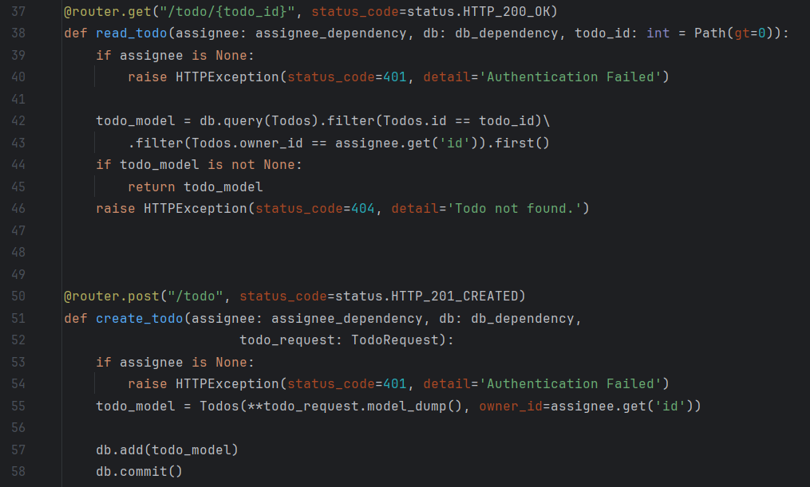
Todos

Slide 13
Future improvements
Add notification for overdue Tasks
Add an administrator with control over the authentication process
Integrate with third-party tools like Slack or Trello

Slide 14
Thanks a lot!
Contact
Massimiliano Stefanuzzi m.stefanuzzzi@gmail.com

